Slide 1
Stages of ARIMA Modeling
Stage 1 Identify the key features of the data and check for stationarity
Stage 2 Preselect models that are compatible with time series characteristics
Stage 3 Estimate model parameters
Stage 4 Select best model using an information criterion.
Stage 5 Perform visual and analytical diagnostics procedures

Slide 2
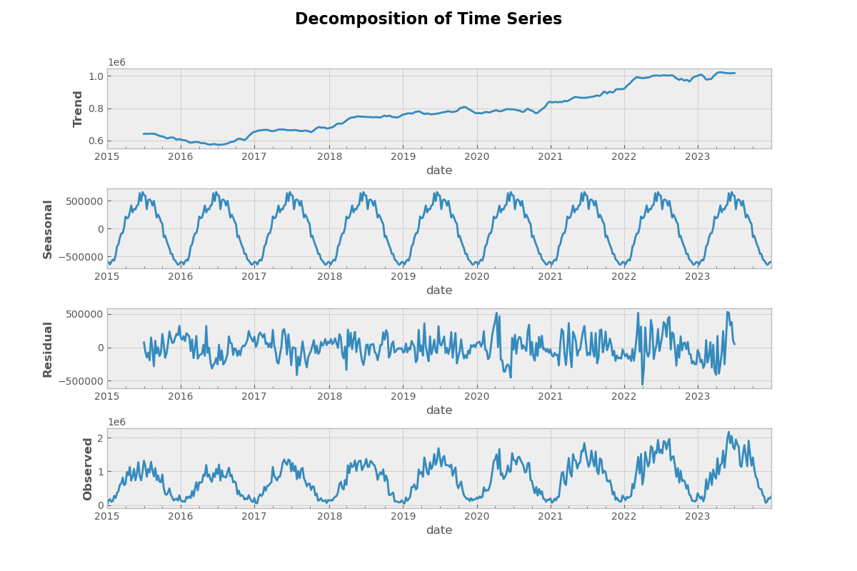
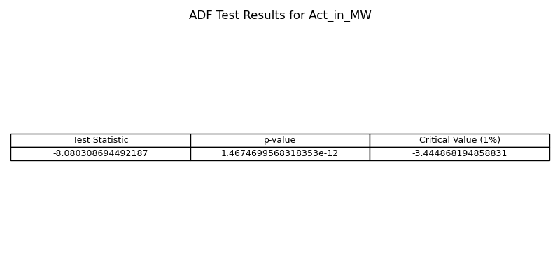
Check for stationarity of time series
Stationary Time Series: It maintains consistent mean, variance, and autocorrelations over time.
  Time Series Analysis: Involves analyzing plots and decomposing features to identify trends, seasonal patterns, and noise.
  Augmented Dickey-Fuller (ADF) Test: Essential for checking the stationarity of a time series.
It provides:
  Test Statistic: Indicates the strength of rejection against non-stationarity.
  p-value: Indicates the probability of observing the test statistic if non-stationarity is true.
  Critical Values: Thresholds for rejecting non-stationarity.

Slide 3
Key Concepts in ARIMA Time Series Analysis
ARIMA model: A forecasting method that combines AutoRegression (AR), differencing, and Moving Average (MA) components to analyze and predict time series data.
  Differencing: A transformation in time series analysis to make data stationary.
  AIC (Akaike Information Criterion): Balances model fit and complexity, guiding model selection by quantifying relative model quality.
AR: Represents the relationship between an observation and its past values in time series analysis.
MA: Represents the relationship between an observation and random error terms in time series analysis.
  ACF plots are utilized to identify the AutoRegression (AR) component, while PACF plots are employed to identify the Moving Average (MA) component.

Slide 4
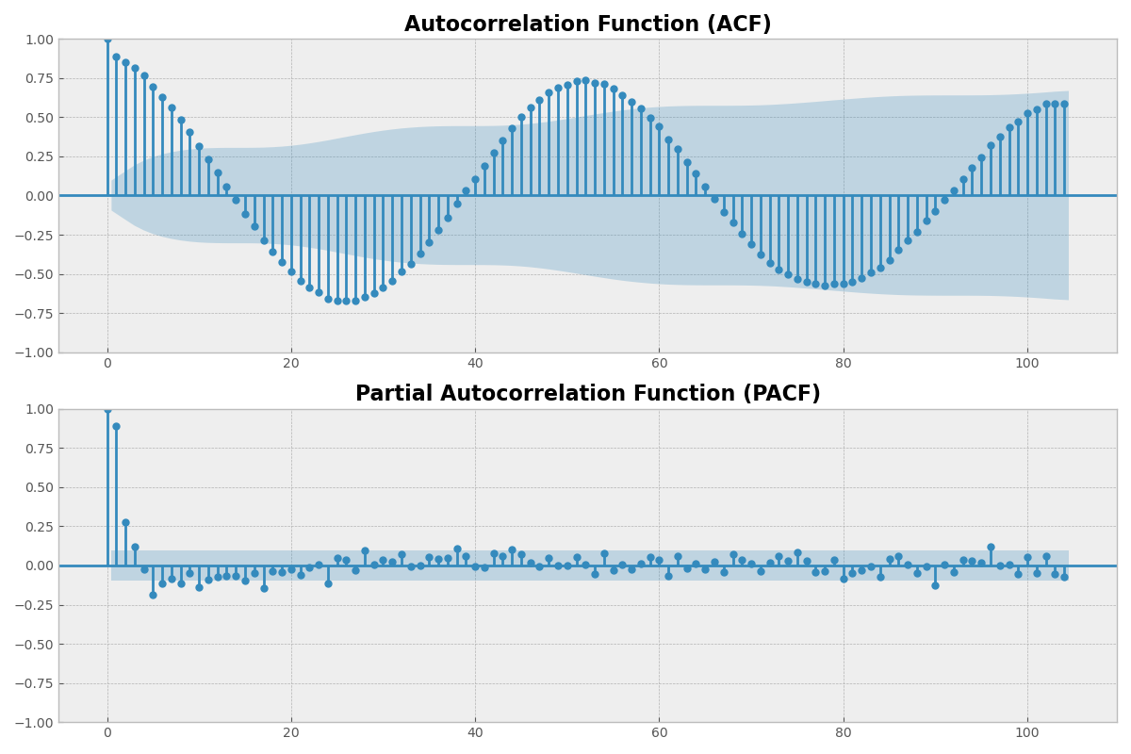
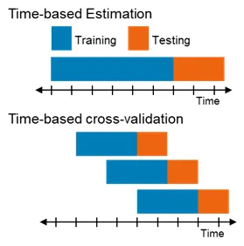
Estimate ARIMA(p,d,q) model Parameters
ACF plot and PACF plot: These plots provide insights into the autocorrelation and partial autocorrelation structures of the time series data.
Time series cross-validation sequentially splits the data based on time to preserve the temporal order of observations, enabling the determination of the best parameter.

Slide 5
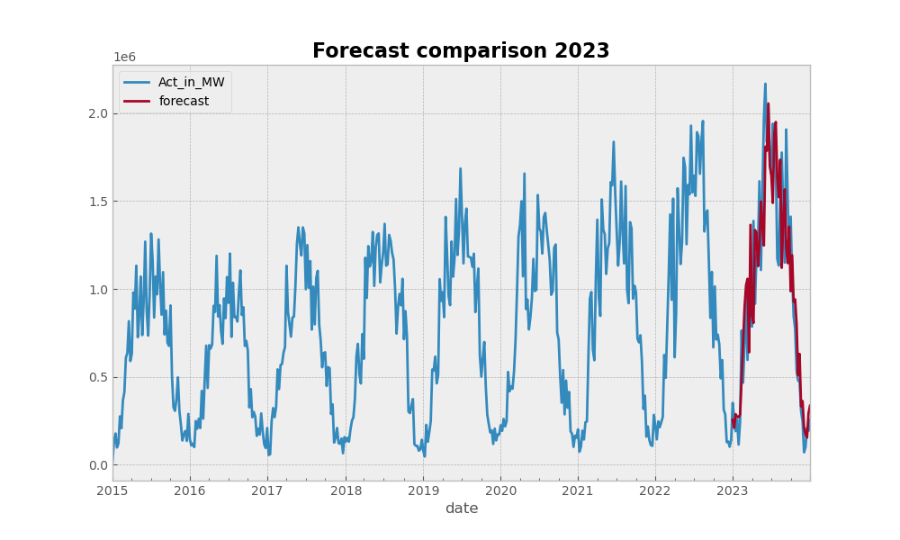
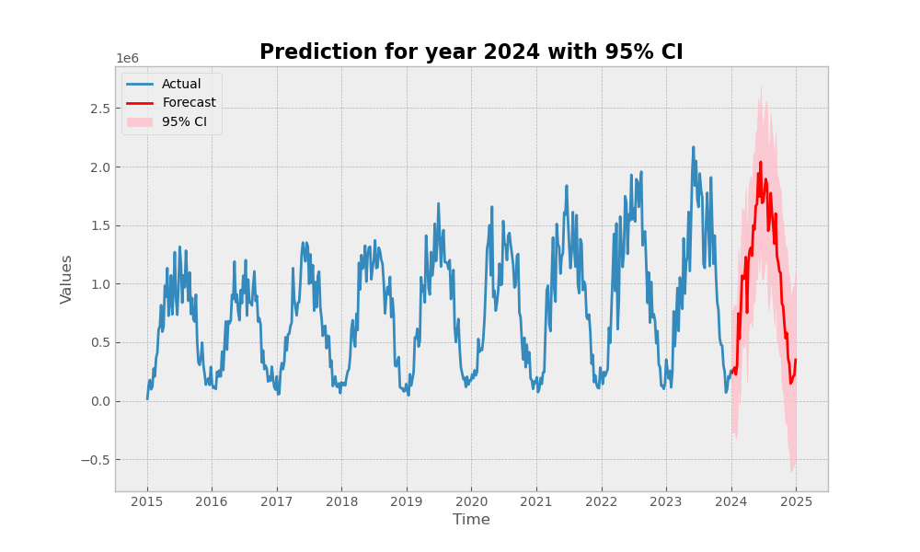
Forecasting with ARIMA Models
SARIMAX model with the following parameter estimates: Non-seasonal Component: (1, 1, 1), Seasonal Component: (1, 1, 0, 52)
we obtain the following insights:
AIC = 11480.522.
The residual variance = 6.744e+10, indicating the variability of data points around the fitted values.
Diagnostic tests: (Ljung-Box = 0.02, JB = 34.87)
  The data shows autocorrelation (Ljung-Box test p-value < 0.05)
  The data is not normally distributed (Jarque-Bera test p-value < 0.05)

Slide 6
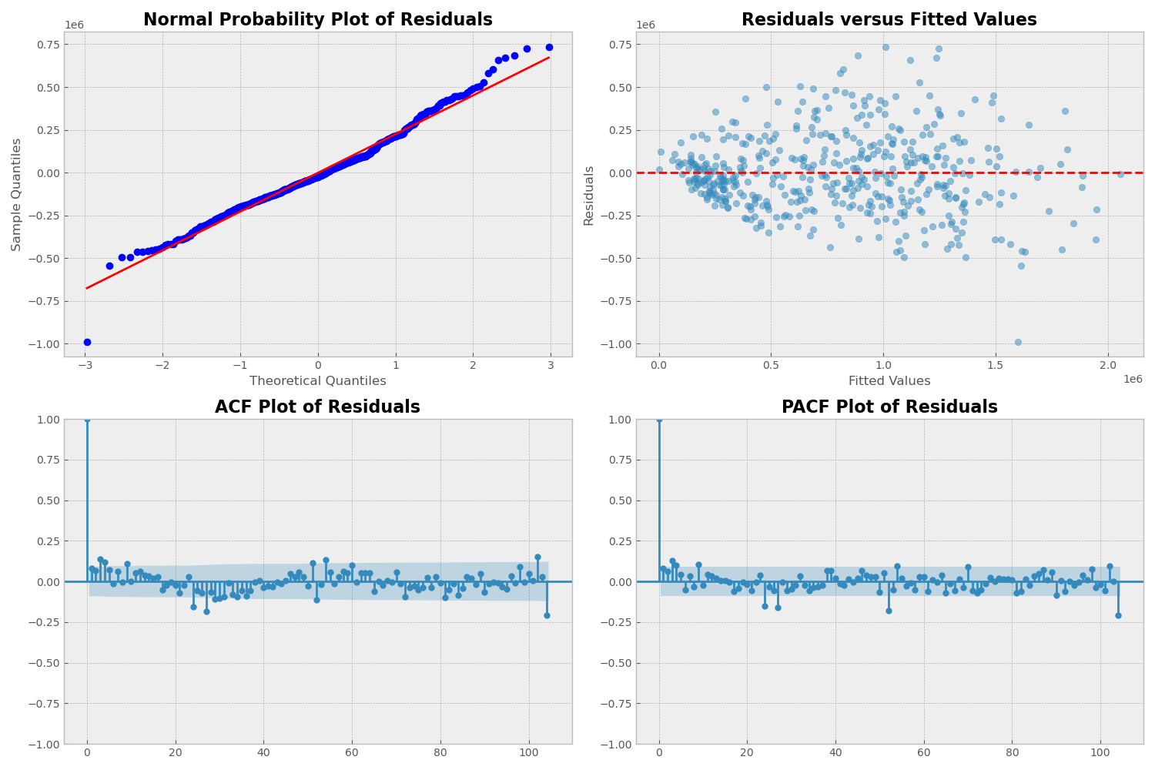
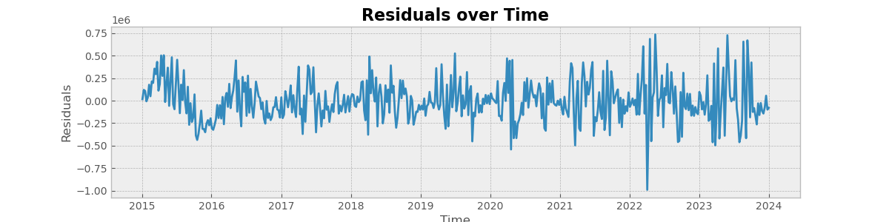
Model Diagnostics
What can go wrong?
  The errors may not be normally distributed
  The data ma contain outliers.
  The time series may be non-stationary.
  The erors may show changing variances over time.
  The mean of the errors may be non-zero
How do we check for these problems:
  Normal probability plot of residuals
  Residuals versus fitted values
  Residuals versus observation order
  ACF/PACF plot of residuals

